Slide 1
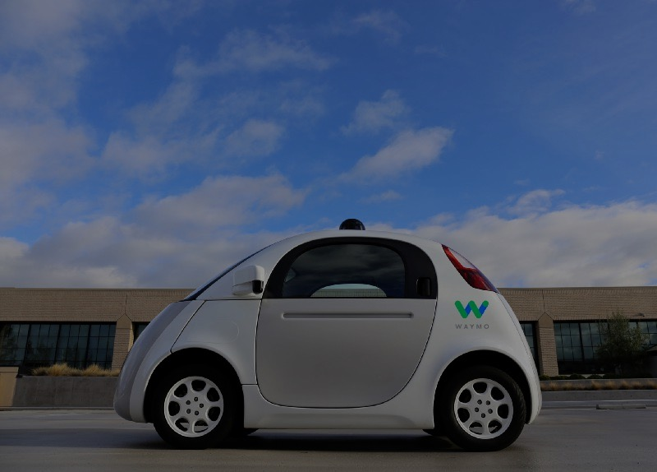
Open-Sourcing Self-Driving Cars
Alexey Simonov

Slide 2
Open Sourcing Self-Driving Cars
Outline
I. Brief History of Autonomous Cars
II. Open Source, DIY, Udacity
III. DEMO: Udacity / Behaviour Cloning
Alexey Simonov

Slide 3
Open Sourcing Self-Driving Cars
I. Brief History of Self-driving Cars
1920s, 50s, 90s …
2005 DARPA Grand Challenge – 132 Miles of Fully Autonomous Desert Driving
Winner: robot Stanley by Stanford Team
http://www.cs.stanford.edu/people/dstavens/thesis/David_Stavens_PhD_Dissertation.pdf
2007 DARPA Urban Challenge – 60 Miles of ‘Urban’ Driving
Winner: CMU/GM team.
Second Place: robot Junior by Stanford Team
http://robots.stanford.edu/papers/junior08.pdf
2009 Google X
Mostly Stanford team develops the first prototypes of Google autonomous cars
~2014 Everyone: big car manufacturers, rides-haring companies, OEM suppliers etc start working on mass-market SDC technology
2017: most companies promise Level 5 autonomy by 2020
Alexey Simonov

Slide 4
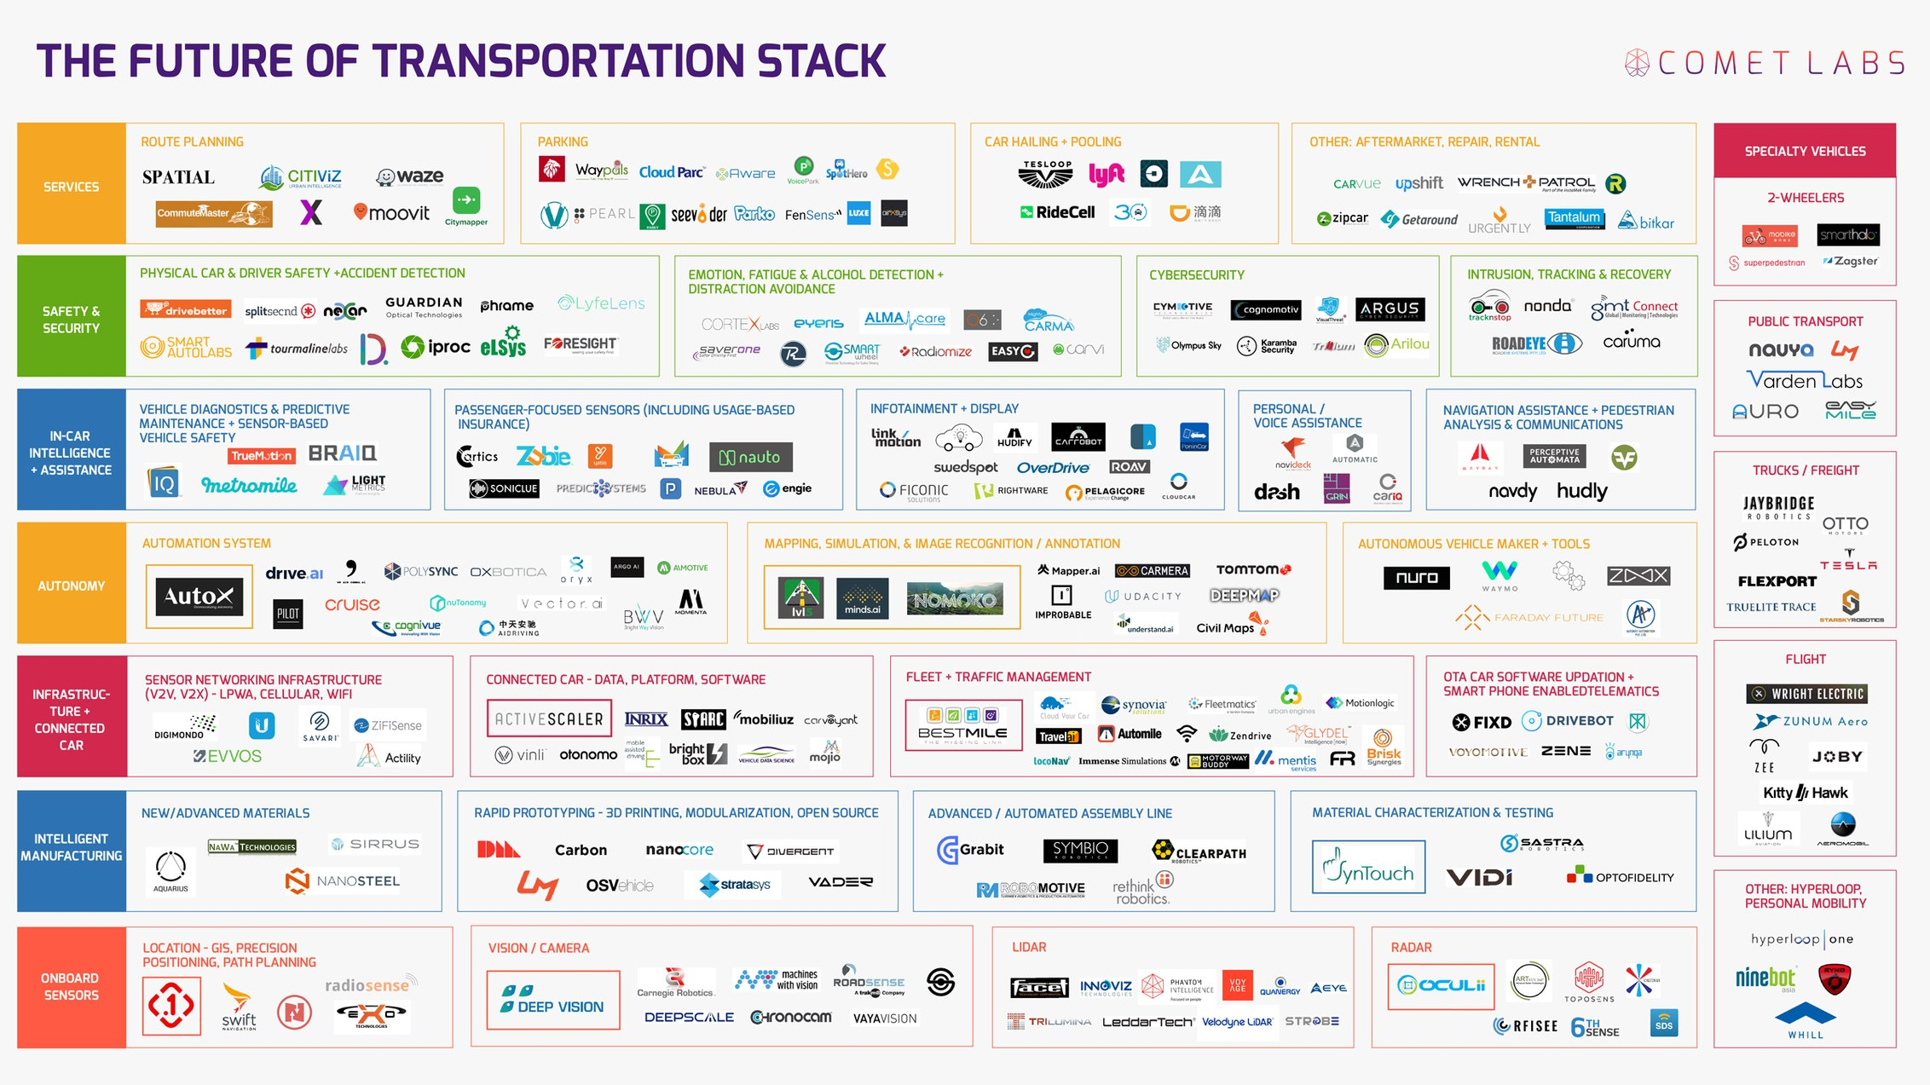
Open Sourcing Self-Driving Cars
I. Brief History of SDC: 2017
Comet Labs: 263 Companies Racing Towards Autonomous Cars
Alexey Simonov

Slide 5
Open Sourcing Self-Driving Cars
I. Brief History of SDC: Main Catalysts
Why now?
Main catalysts:
Advances in car technology
Electric powertrain
Drive-by-wire controls
Advanced driver assistance systems
Cheaper and better sensors: cameras, RADARs, LIDARs
Connectivity/Cloud/Big Data
detailed 3D maps
traffic, driving patterns data
other crowd-sourced data
AI / Machine Learning / Computer Vision
Better compute capabilities at ‘The Edge’ – GPUs, ASICs etc
State of the art results in image recognition/classification
State of the art results in reinforcement learning
Alexey Simonov

Slide 6
Open Sourcing Self-Driving Cars
II. Open Source: It is all about SOFTWARE
Logical Next Step: Open-Source [self-driving cars]
We know this in PyData community ☺
Seriously?
Well, it turns out it is [almost] all about software.
Autonomous car is a ROBOT, which does the following, in a loop:
Perceive the world through sensors (HARDWARE)
Make sense of the world and plan an action (SOFTWARE – 90%)
Execute the action (HARDWARE)
April 2017: https://www.technologyreview.com/s/604220/baidu-will-release-a-free-operating-system-for-self-driving-cars/
I told you! We’d better be quick, after all we use Python and they are probably on C++!
Alexey Simonov

Slide 7
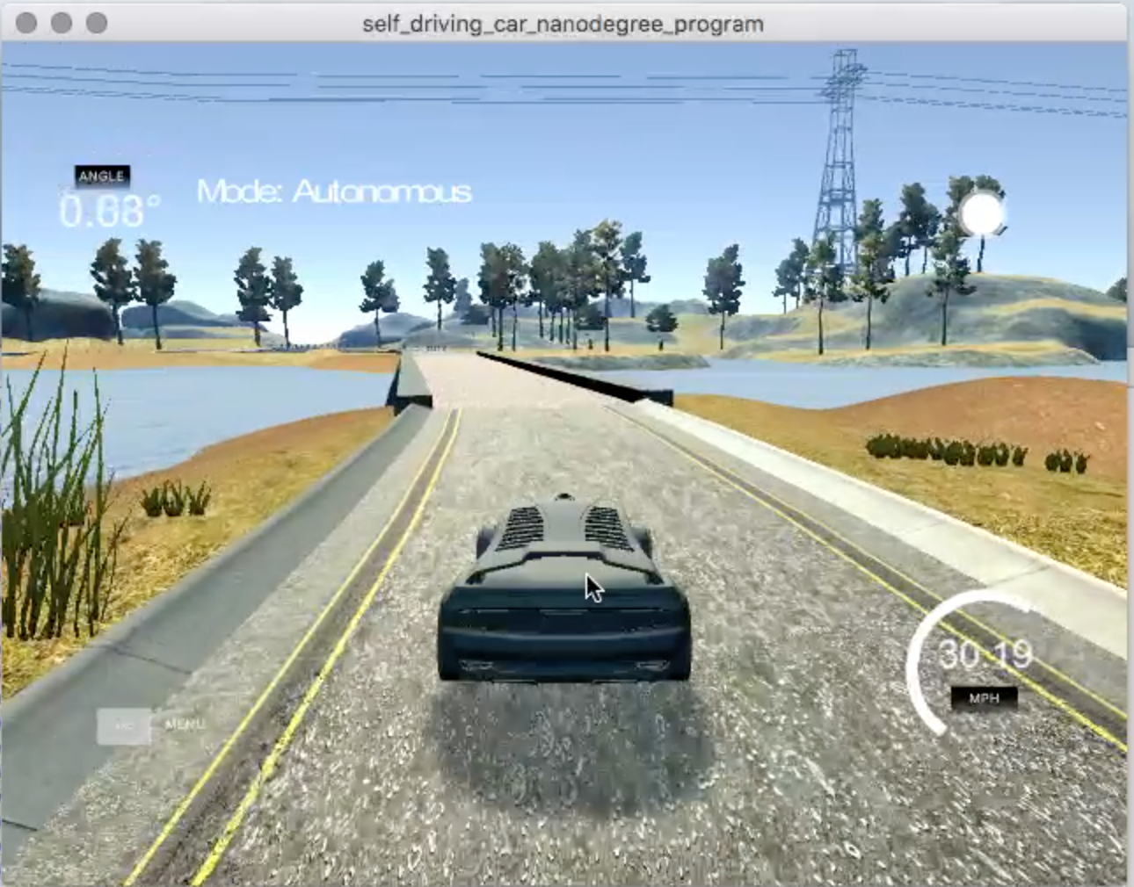
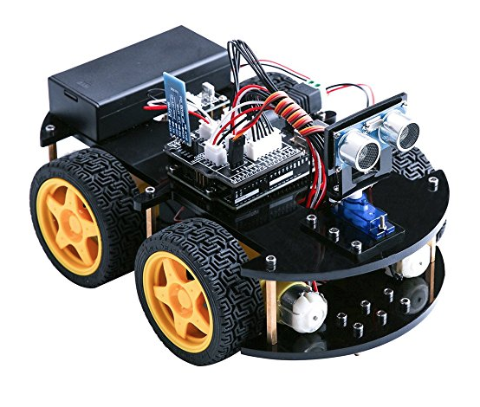
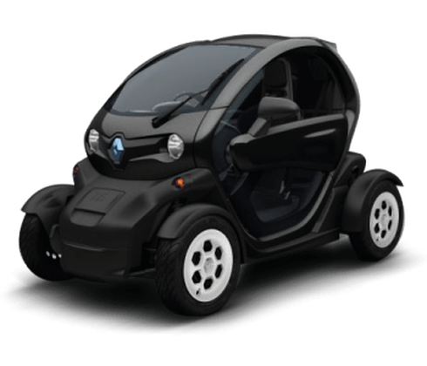
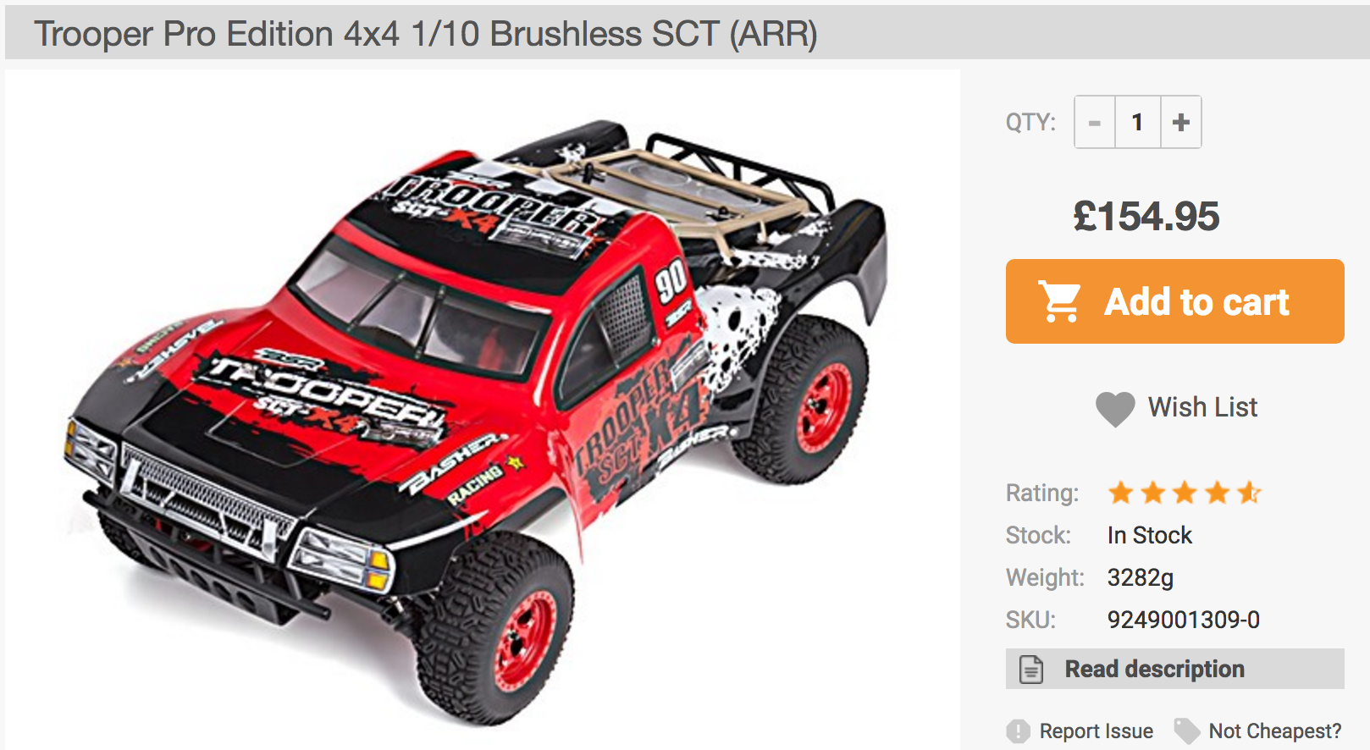
Open Sourcing Self-Driving Cars
II. Open Source: Hacking, DIY
So, how do I hack a self-driving car?
Choose hardware platform:
Simulator / ROS
toy
medium-size (1/10)
full-size (streetdrone.co.uk)
Alexey Simonov

Slide 8
Open Sourcing Self-Driving Cars
II. Open Source: More Hardware Ideas
More hardware ideas:
Drive-by-wire Kits For Full Size Vehicles (available to public)
http://oscc.io/ - 1000$ Kia Soul 2014+, https://github.com/PolySync/OSCC
http://www.autonomoustuff.com/wp-content/uploads/2016/08/ADAS-Development-Vehicle-Kit.pdf - Lincoln MKZ or Ford Fusion
DIY Toy Car Kits:
https://mit-racecar.github.io/hardware/ - based on https://traxxas.com plus NVIDIA Jetson plus cameras, laser range sensors, IMU and ECU for wheel odometry
https://diyrobocars.com/raspberrypiarduino-car/ -- and many other designs
https://docs.google.com/spreadsheets/d/1iaOru6va1LXjhXfBtYTWhAH_3DQlvVIdpRZ0NJh-7q8/edit?usp=sharing -- possible configuration
Alexey Simonov

Slide 9
Open Sourcing Self-Driving Cars
II. Open Source: Data and Programming
Open-Source Software
Tensorflow and other Deep Learning frameworks
OpenCV for computer vision
ROS – Robotics Operating System
Trained models for object detection, image segmentation, visual SLAM
…
Open Data Sets
http://synthia-dataset.net/
http://www.cvlibs.net/datasets/kitti/
http://ori.ox.ac.uk/the-oxford-robotcar-dataset/
…
Alexey Simonov

Slide 10
Open Sourcing Self-Driving Cars
II. Open Source: Meetups and Projects
Meetups:
https://www.meetup.com/DIYRobocars -- California
https://www.meetup.com/London-Self-Driving-Autonomous-Car-Technology-Meetup/
Open Source Projects:
https://github.com/OSSDC -- Open Source Self Driving Car Initiative
http://comma.ai/
Alexey Simonov

Slide 11
Open Sourcing Self-Driving Cars
III. Udacity Nanodegree
Udacity started a (paid) nano-degree in October 2016
Self-Driving Car Engineer:
Term 1
Deep Learning
Computer Vision
Term 2
Sensor Fusion
Localization
Control
Term 3 (under development)
Path Planning
Elective (Advanced Deep Learning or Functional Safety)
Team Project / Write a Component for Udacity Self-Driving Car
Alexey Simonov

Slide 12
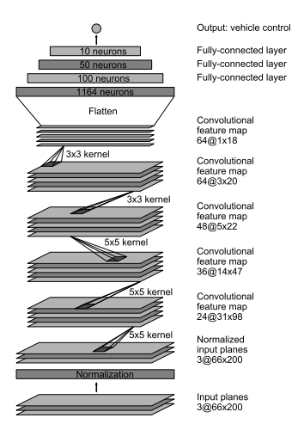
Open Sourcing Self-Driving Cars
III. DEMO: Behavioural Cloning
Project from Term 1 at Udacity SDCEND
Use Deep Learning to drive car in a simulator
Python, tensorflow, keras
https://github.com/asimonov/PyData-London-SDC-Behavioural-Cloning
Alexey Simonov

Slide 13
Open Sourcing Self-Driving Cars
III. DEMO: Behavioural Cloning. Ways to go
There are multiple ways to go from here:
Use real data (one of open SDC data sets)
Incorporate other measurements into the model (throttle, speed, desired path)
Use transfer learning
Transfer to embedded system
For example Raspberry Pi. Or NVIDIA Drive PX.
https://petewarden.com/2017/05/08/running-tensorflow-graphs-on-microcontrollers/
The best resource to understand what is going on in your Deep Net and where to go from here:
http://cs231n.github.io/
Alexey Simonov

Slide 14
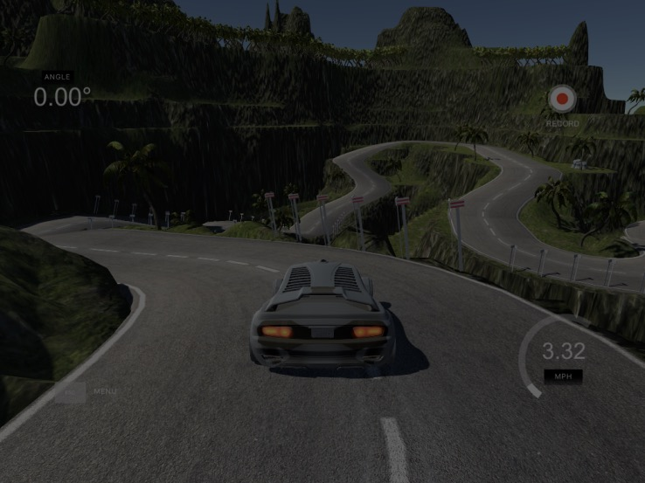
Thank you!
Key Takeaway: with Python autonomous cars are easy!
Questions?
Alexey Simonov
https://www.linkedin.com/in/alexeysimonov/

